Slide 1
Mucular/Skeletal Presentation:
by Michael C, Max V, Richard Y, Amritha S,
Kyle R, Sam B, Cosette S

Slide 2
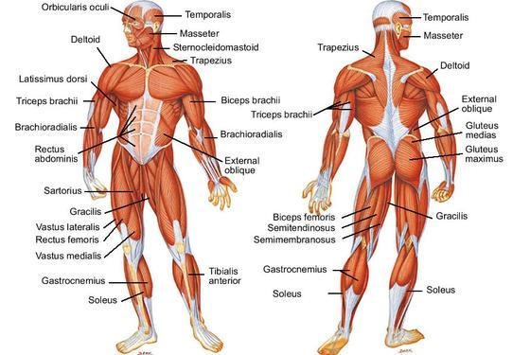
Introduction:
People move because the have muscle and bone. Without such things we would be blobs of fat lying on our immovable extremities.
“A human puddle.”

Slide 3
Function, In General:
As a whole, muscular system allows movement in body (ex. standing up, sitting down, pumping blood, etc.)
Most of nervous system impulses → muscle movement
Body cannot function w/o muscular system

Slide 4
Specifics: Skeletal Muscle
Skeletal muscles cover the skeleton and are attached to the bones, tendons, and ligaments
Fully deal with the voluntary movements
Convert energy from food into ability to move
Stabilize human skeleton, give it posture, and protect internal organs
When we think of using them, nervous system sends impulse telling them to move

Slide 5
Specifics: Cardiac Muscle
Cardiac muscles are found in the heart
Responsible for (1)forcing blood out of heart, (2)makes sure it circulates through body, (3)nutrients come to tissue, and (4) wastes get taken away

Slide 6
Specifics: Smooth Muscle
Involuntary = we do not have direct control over muscle function
Smooth muscles are the involuntary ones that line internal organs such as blood vessels and the stomach
Ex. Smooth muscles of digestive system contract and allows digestion
Ex. Contractions of the smooth muscles of uterus allow childbirth
Ex. Maintain blood flow in body

Slide 7
Structure of Muscles
The Breakdown
→ skeletal muscles → bundles of muscle fibers → myofibrils → filaments made of actin and myosin → divided into sarcomeres, functional units
striated muscles - muscle tissue that has repeating sarcomeres
sarcomeres separated by z-discs
striations formed by alternating pattern of filaments
thick filaments made up of myosin
thin filaments made of actin

Slide 8
How it works
Muscle contractions caused by force produced by myosin and actin
filaments
Muscles move when thin filament in fiber slides over thick filament
All the muscles in your body use oxygen and
glucose as a main source of energy. The oxygen allows the glucose to convert to ATP, which is what fuels muscle contractions.
When oxygen is not present, glucose is
converted to lactic acid instead, which is an inefficient fuel source that causes fatigue.
Nerve impulses from brain relatively always result in
muscle movement

Slide 9
How it works: Control
Neuromuscular junction -contact point between motor neuron and skeletal muscle cell
Vesicles in the motor neuron release acetycholine, a neurotransmitter, which produces an impulse that causes myosin and actins to work through releasing calcium ions that affect the needed regulatory proteins
this leads to muscle contraction
muscle cell stays contracted until acetycholine stops producing and all other processes stopped

Slide 10
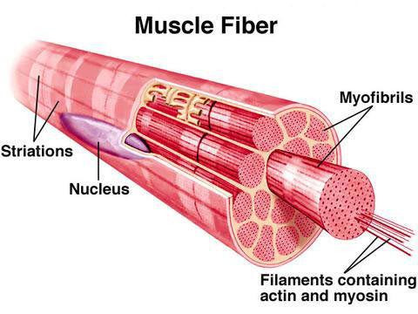

Slide 11
Skeletal System:
For our first model, we made a working model by using wooden dowels as the bone and adding a hinge joint
For our second model, we made a clay model showing the layers and parts of the bone

Slide 12
Structure Of A Bone
Outer Shiny Layer - Periosteum
Cortex - Compact Bone
Interior Layer - Spongy Bone
Two Marrows of a Bone - Yellow and Red
Red Marrow located in the heads of the bone
Yellow Marrow runs throughout the shaft

Slide 13
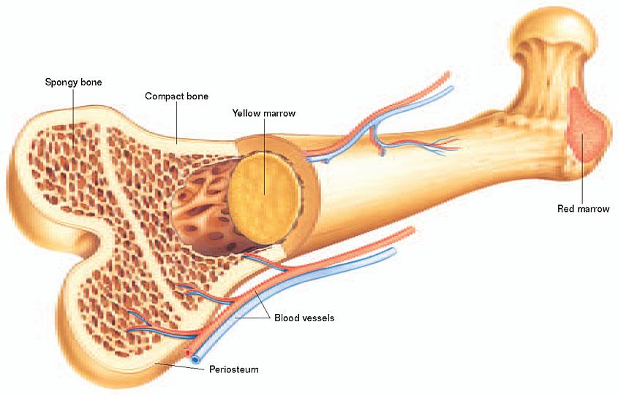

Slide 14
Function:
The Skeleton supports the body and protection for some organs
The Skeleton is a base for the muscles to pull on for movement
Each bone has a marrow in which blood cells are formed
Bone also store calcium for the body

Slide 15
Our Model Explained
Function 1 - demonstrating how a hinge joint works, and how the bones in the arm act in accordance to the muscles contracting
Function 2- to show how muscles work in pairs; when the bicep is contracted, the tricep is relaxed, vise versa
Function 3- to give a general view of the anterior forearm
Function 4- to show how fingers and the tendons in the hand work together

Slide 16
The Building Process: Designing
Because both groups decided to work together, we knew we needed to choose a type of model that fit both our needs. Therefore, we decided to model an arm, since it showed both the purpose of the skeletal system and muscular system and clear to show on exhibition
Afterwards, we had a brainstorming session to determine how our model was to be made. With those basic ideas, we sketched a rough draft and built a crude model. No idea was ever shot down without a reason or trial.
After building started, we just added on to the model when someone had a new, probable idea. There was constant redesigning and tweaking throughout the entire process

Slide 17
The Building Process: Problems
work distribution was not at all even
we were slow building the model
we went into building with a bunch of unknown factors. We had a general idea of what to bring and what we wanted, but it wasn’t enough to build a fully functional model

Slide 18
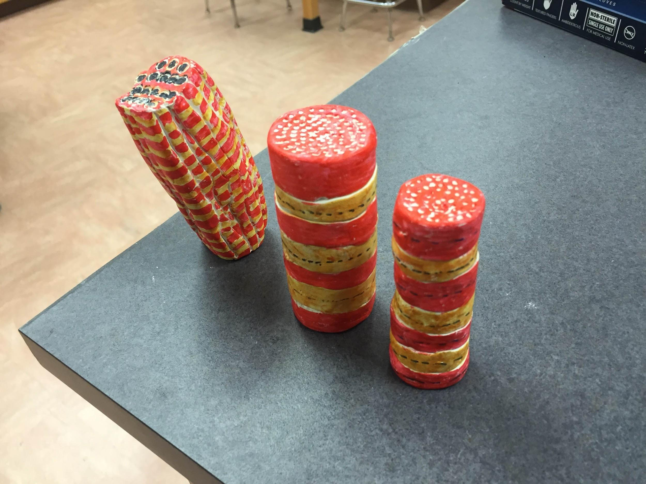
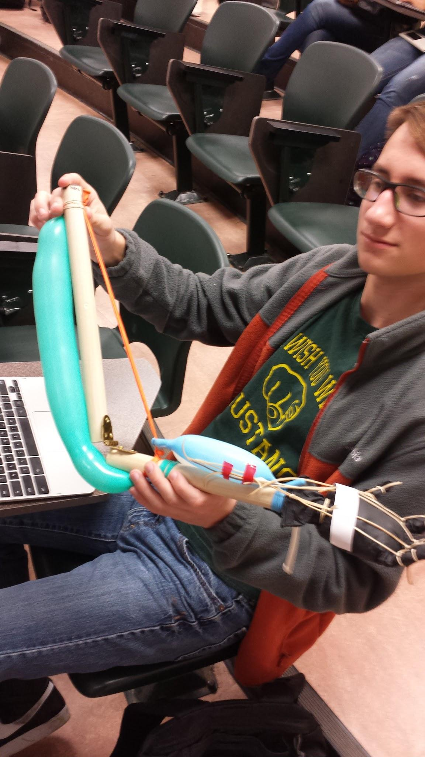
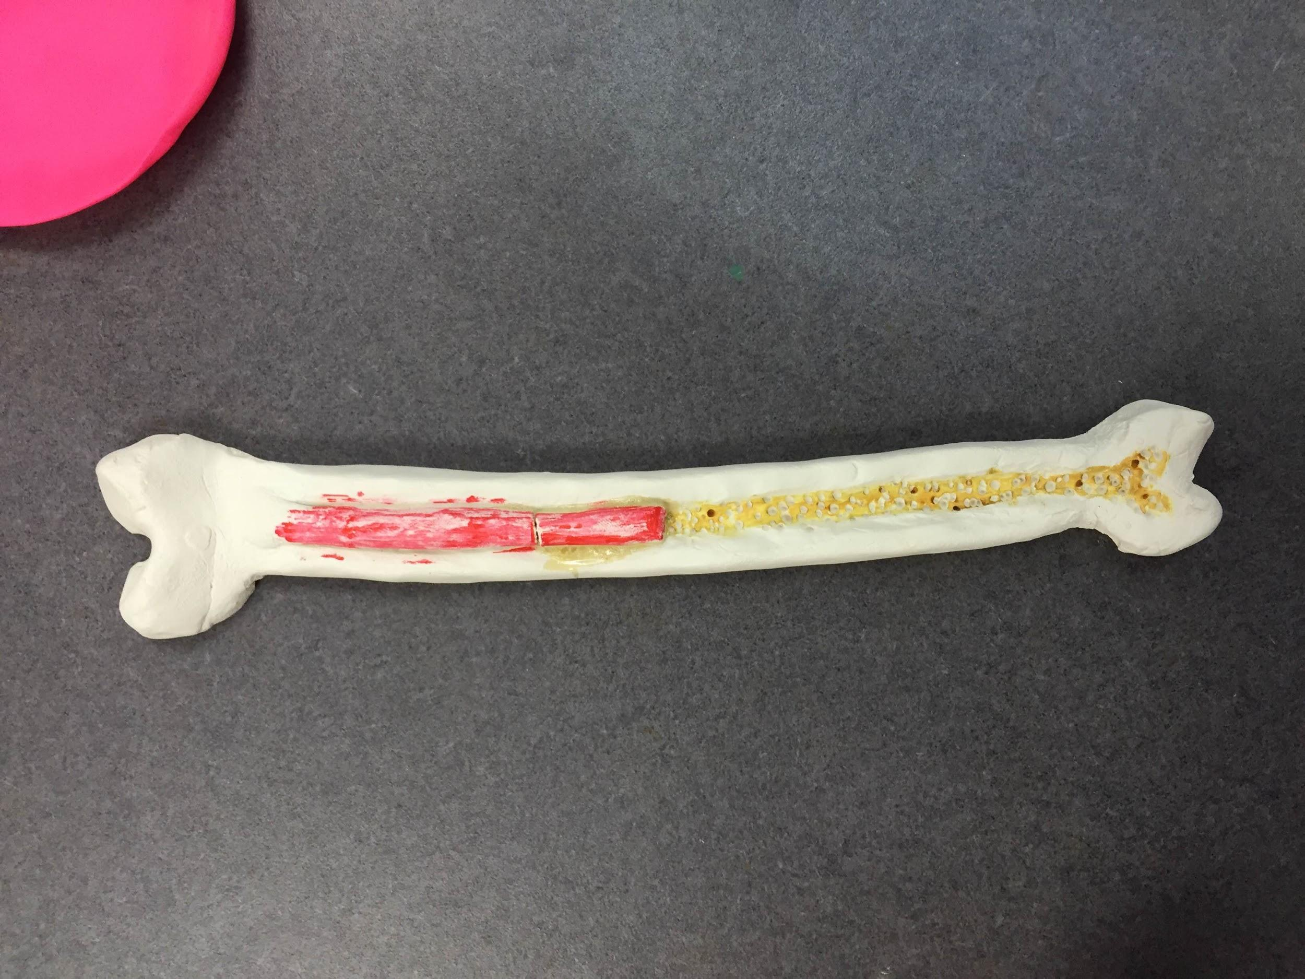
Models:

